Slide 1

Mini Project on Tecko database
Submitted to- Submitted By
Mr.Vijay Prakash Bijlwan Kartikeya
18134503008
B.Tech.CSE 6th sem
Department of Computer Science & Engineering
School of Engineering & Technology

Slide 2
Content
Overview of Project
Technology stack used
Modules
Labels,Entries,List box,Scrollbar & Buttons
Defining Backend
Adding & Viewing data
Searching & deleting data
Conclusion

Slide 3
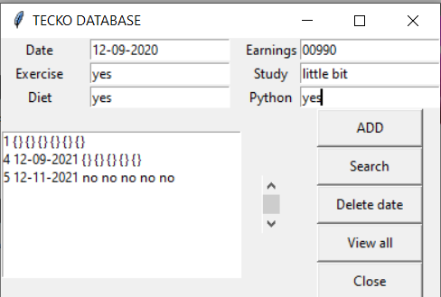
Overview of project
Tecko Database

Slide 4
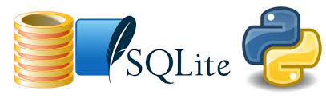
Technology Stack Used
Language-
a.Python(Tkinter)
b.SQLite3
Editor-
a. VS Code

Slide 5
Modules
Frontend
Backend
Routine

Slide 6
Labels,Entries,List box,Scrollbar & Buttons
Labels have including information on a entries origin.
A list box is a graphical control element that allows the user to select one or more items from a list contained within a static, multiple line text box.
Scrollbar is basically use for viewing all data in database.
Buttons are used for data saving, viewing,searching & deleting.

Slide 7
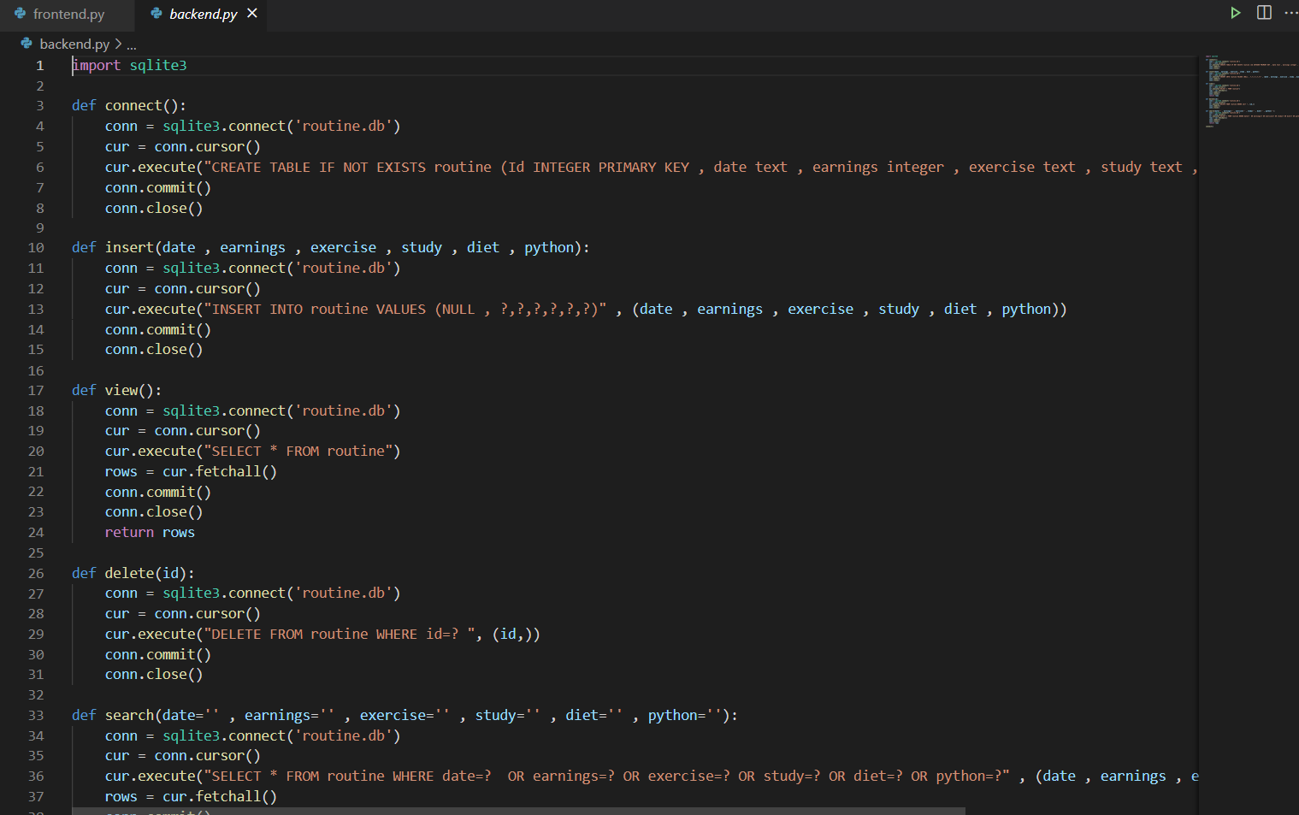
Defining Backend

Slide 8
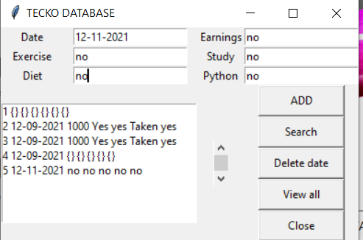
adding & Viewing data
Adding Viewing

Slide 9
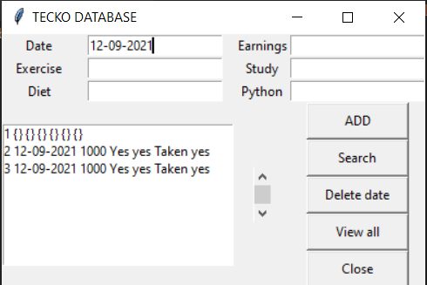
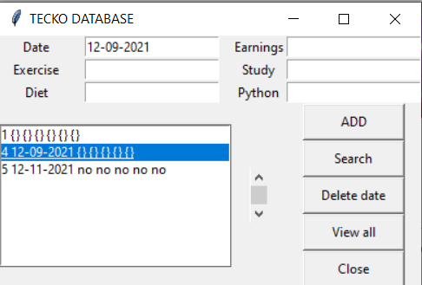
Searching & deleting data
Searching Deleting

Slide 10
Conclusion
We can use this database is as Routine Calender
We don’t require any type internet connection.
In future, we implement more labels.

Slide 11
References
https://medium.com/analytics-vidhya/programming-with-databases-in-python-using-sqlite-4cecbef51ab9
https://stackoverflow.com/

Slide 12
Thank you

